Slide 1

Pietro Ceccato
Using MODIS and VIIRS in Vector-Borne Disease Risk Characterization

Slide 2
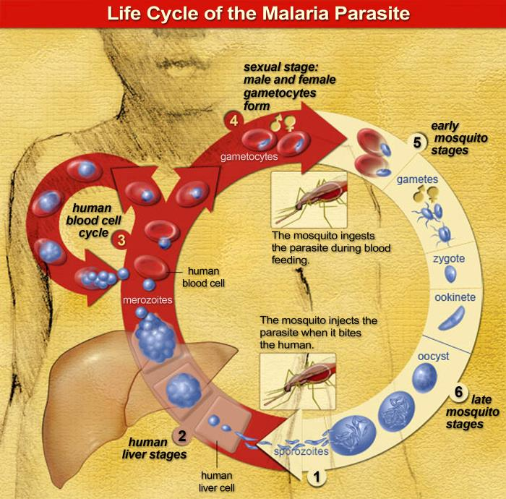
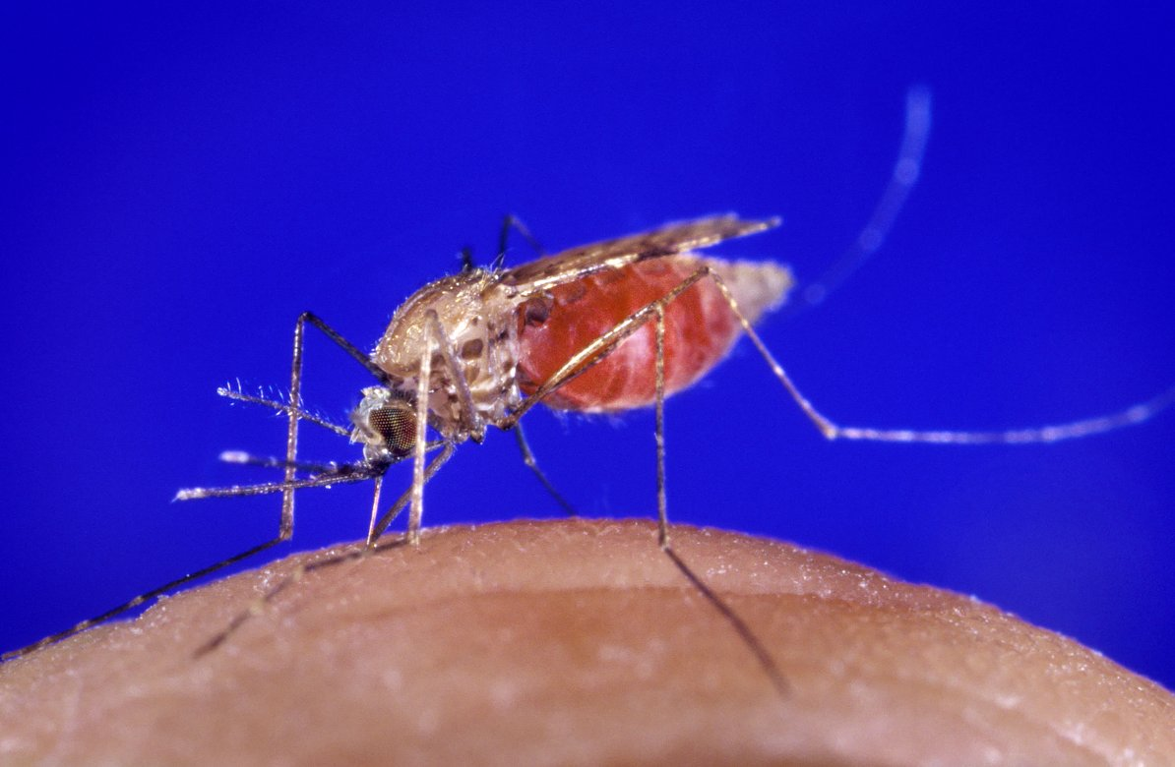
Malaria
Collaborations with:
World Health Organization,
Ministries of Health in Africa,
PMI USAID

Slide 3
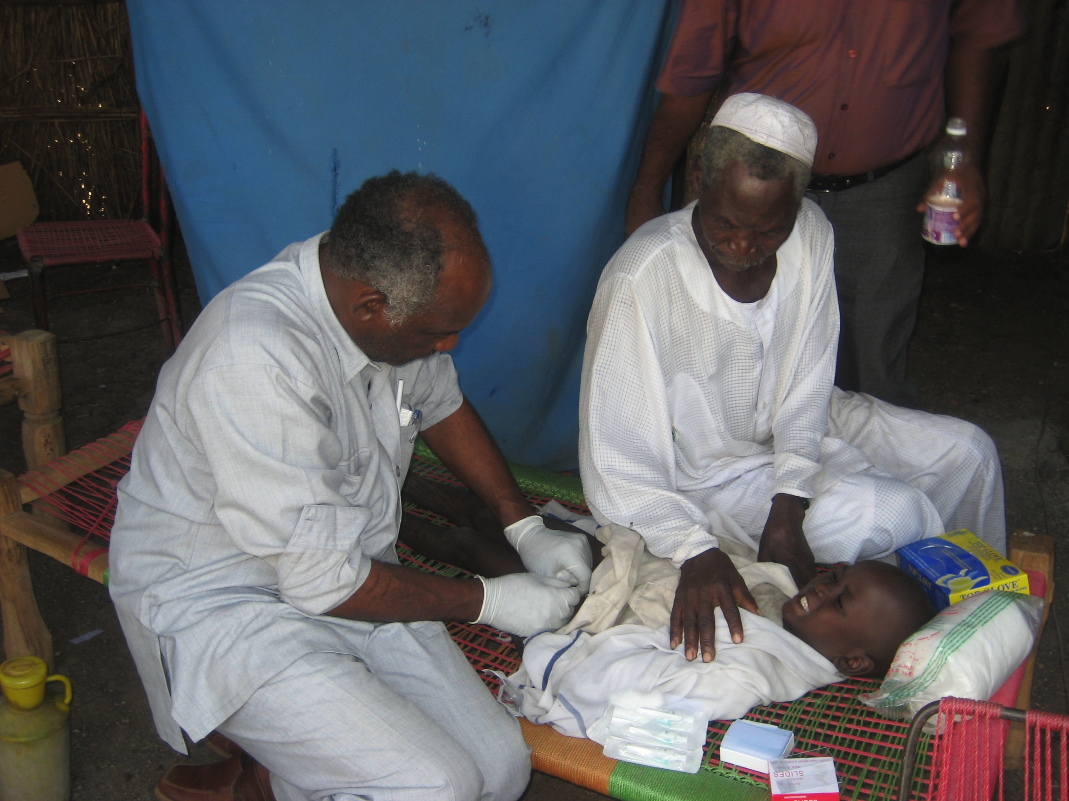
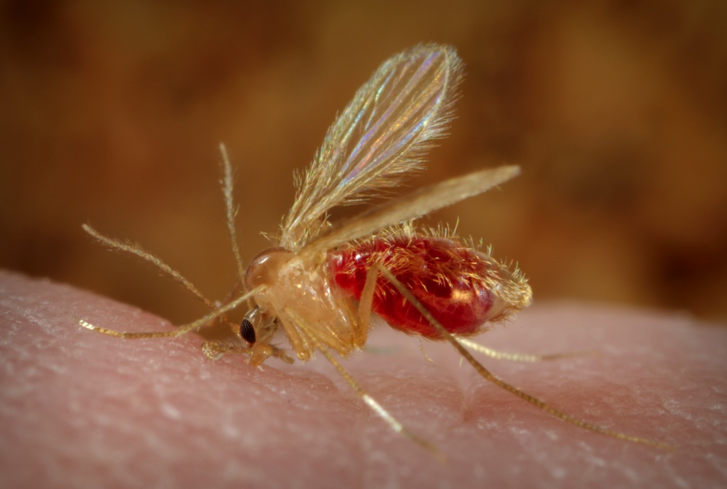
Leishmaniasis
Collaborations with:
Médecins Sans Frontières,
South Sudan

Slide 4
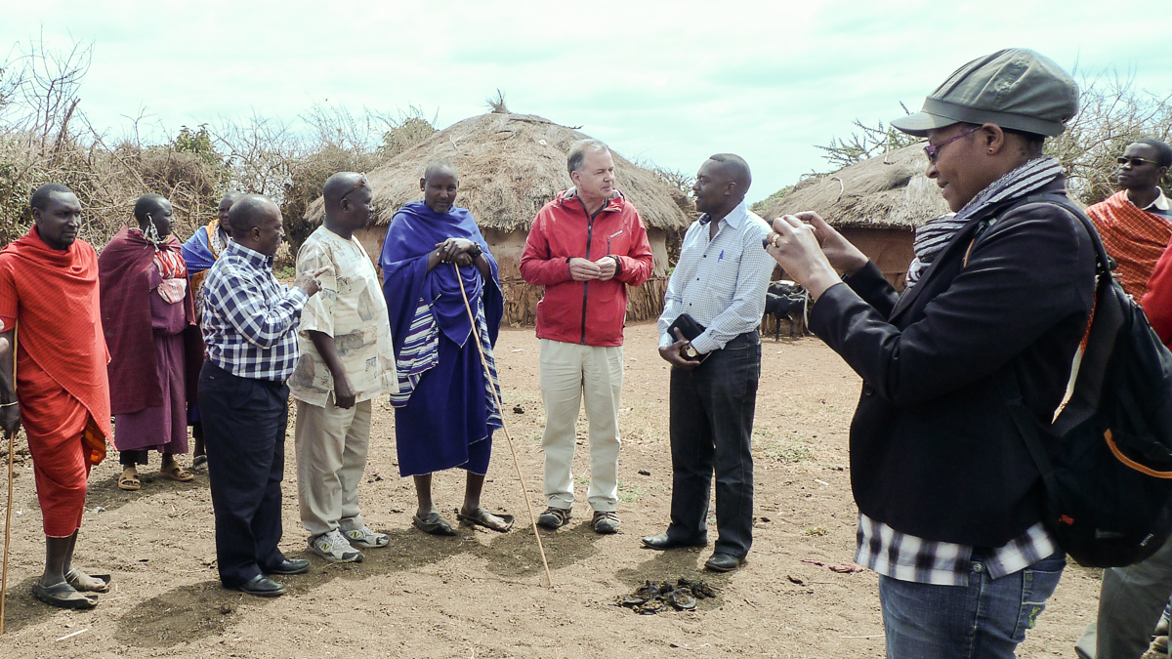
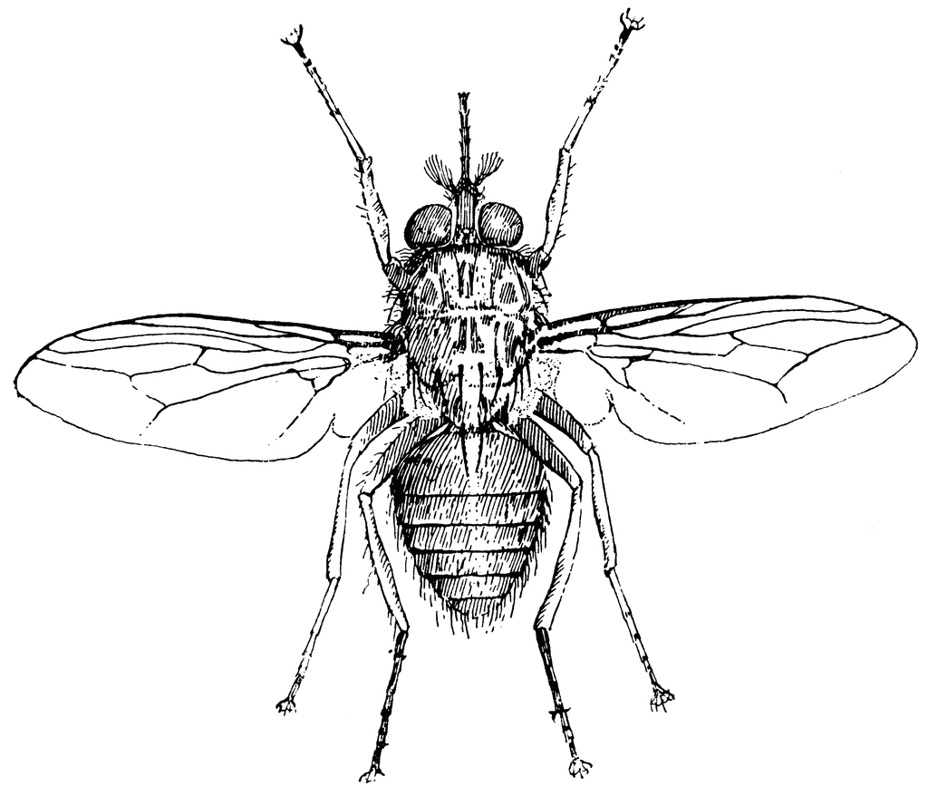
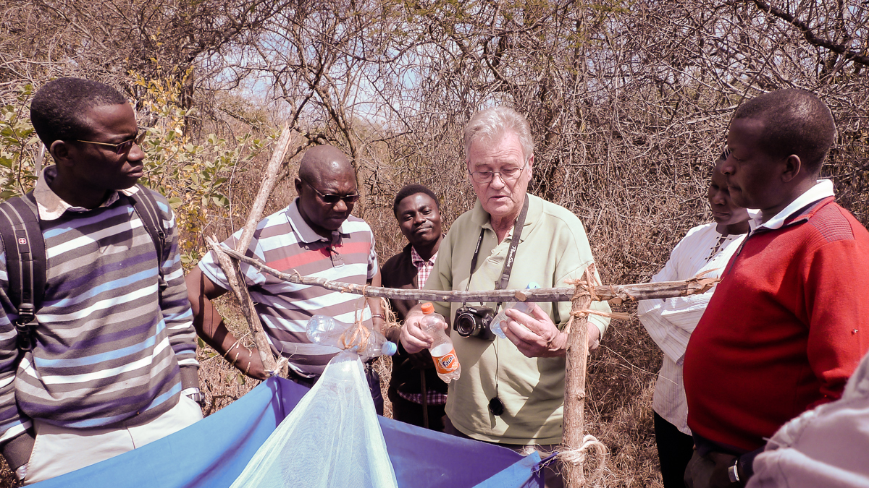
Trypanosomiasis
Collaborations with:
World Health Organization,
Nelson Mandela University
Masai village in Tanzania affected by trypanosomiasis
John Hargrove providing expertise on tsetse fly

Slide 5
Requirements
Create Stratification Maps
Create Early Warning Systems
Evaluate the Efficacy of Control Measures

Slide 6
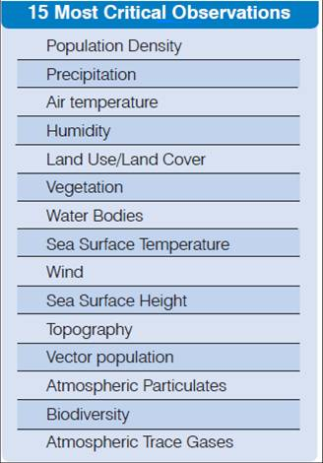
Environmental Factors
Ceccato 2010, GEO Task US-09-01a: Critical Earth Observations
Priorities
http://sbageotask.larc.nasa.gov/InfectiousDisease_US0901a-FINAL.pdf

Slide 7
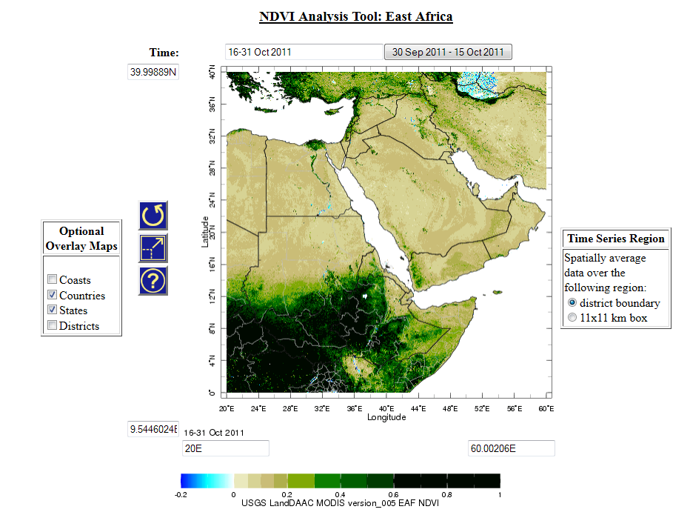
MODIS vegetation indices to monitor changes

Slide 8
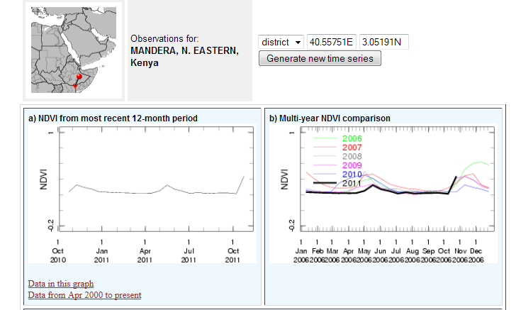
MODIS vegetation indices to monitor changes

Slide 9
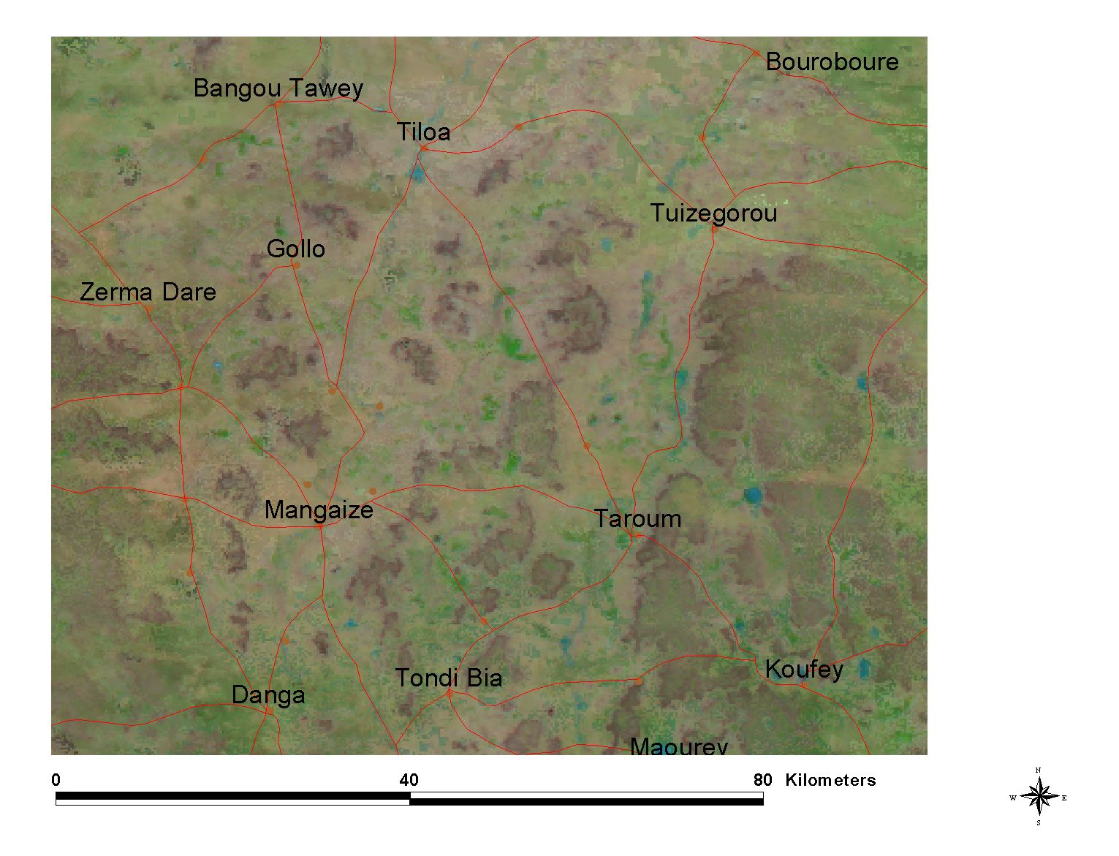
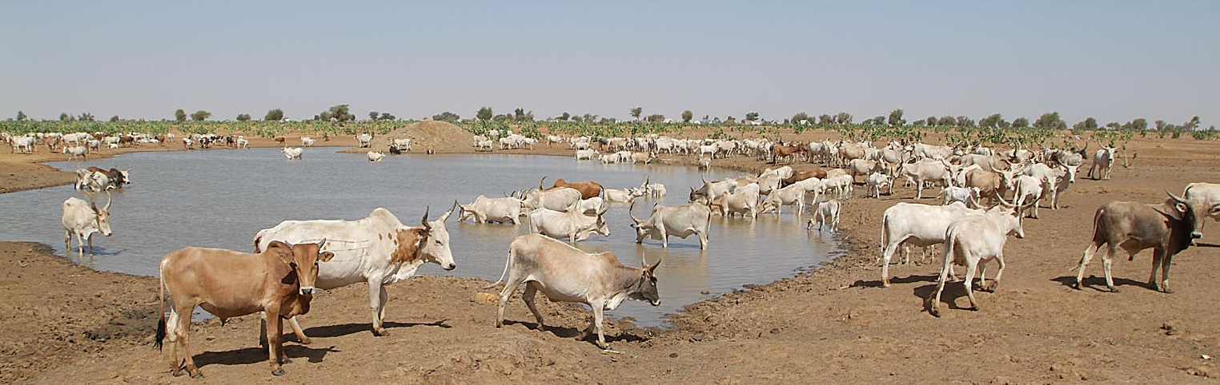
MODIS Reflectance in Red-NIR-MIR to monitor
Water Bodies

Slide 10
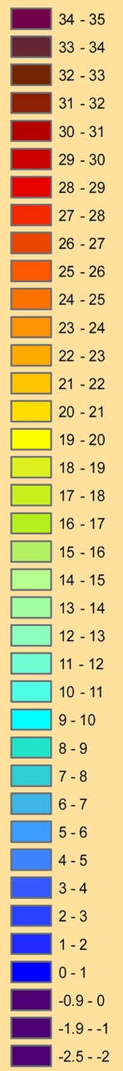
MODIS LST night and day to estimate air temperature

Slide 11
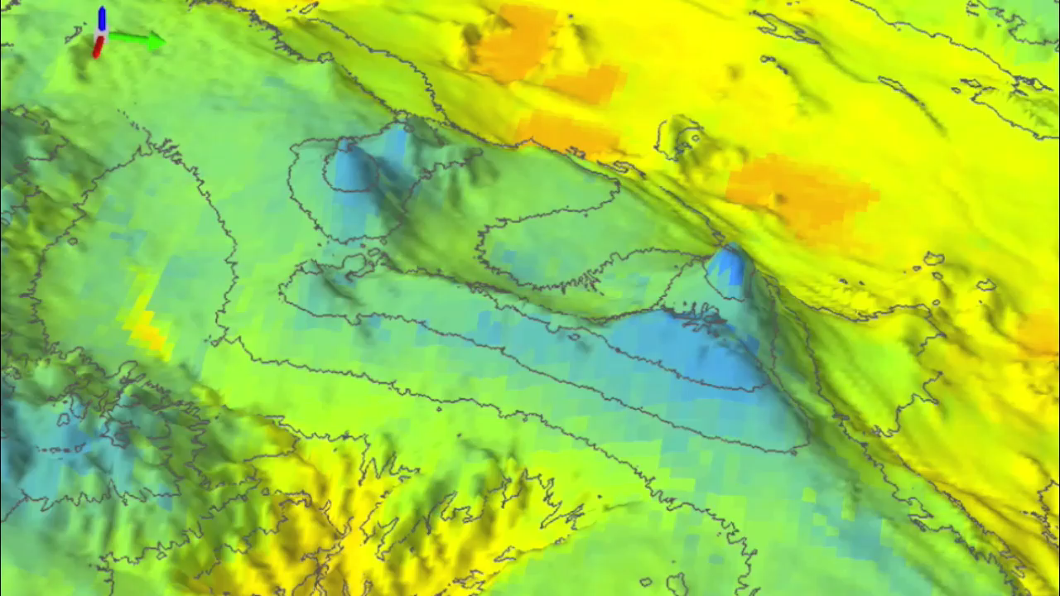

Slide 12
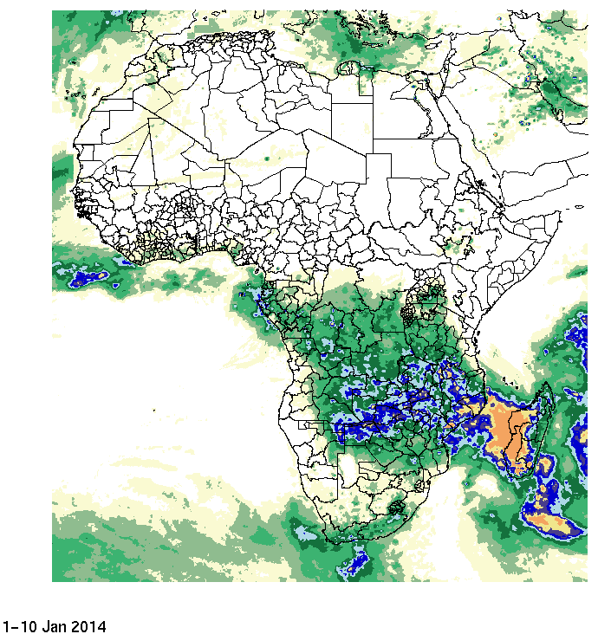
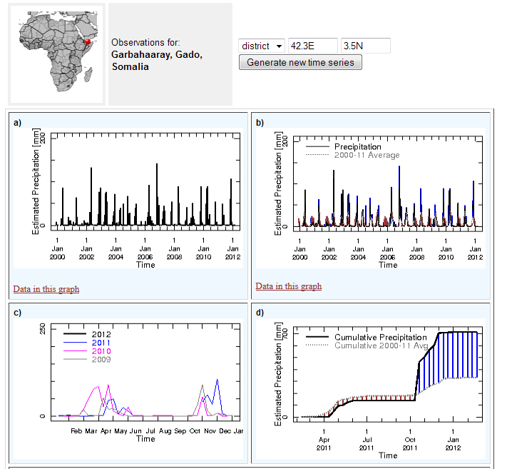
Requirements i) Provide easy Access, ii) easy Visualization, iii) easy Analysis and iv) easy Download
IRI Data Library: http://iridl.ldeo.columbia.edu/maproom/

Slide 13
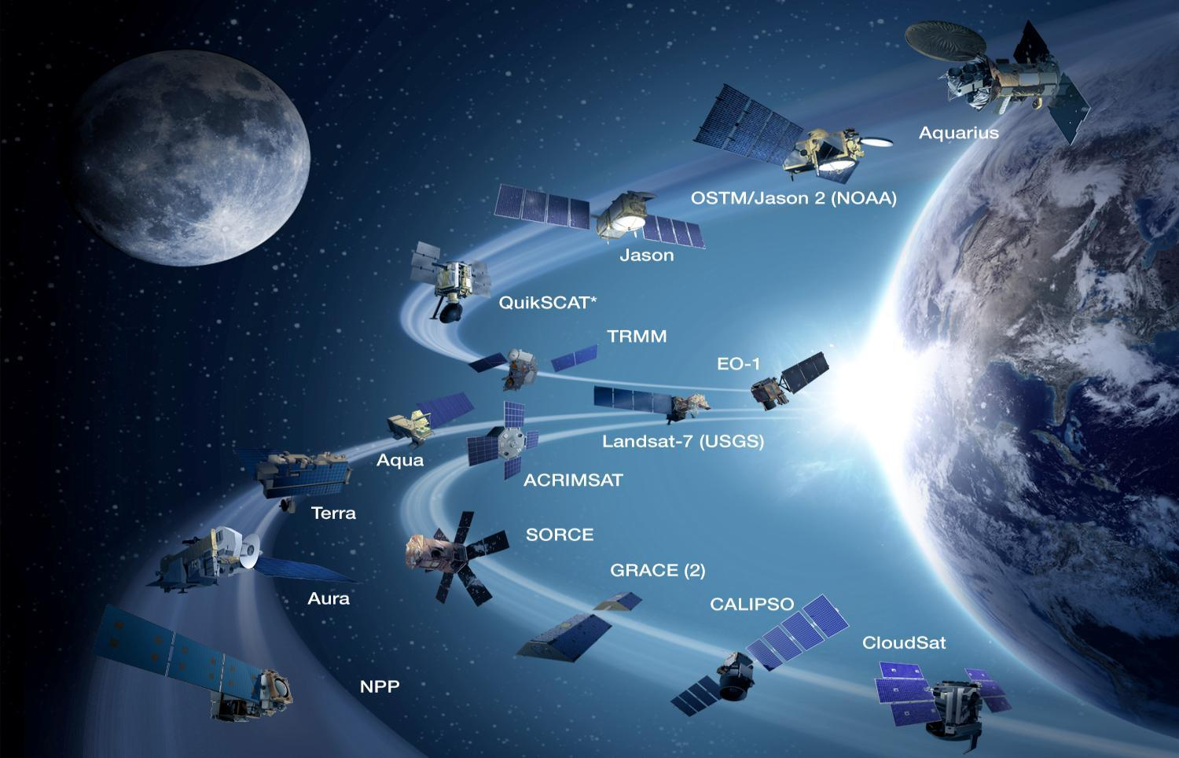
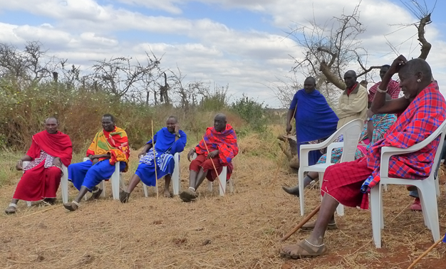
Connecting Space
To Village

Slide 14
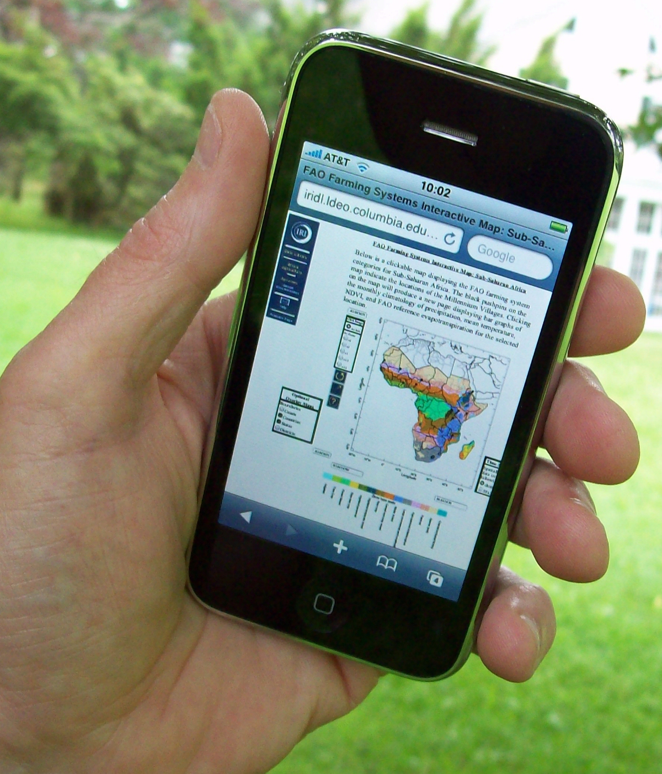
Dissemination of Information to Local Communities
IRI Data Library: http://iridl.ldeo.columbia.edu/maproom/

Slide 15
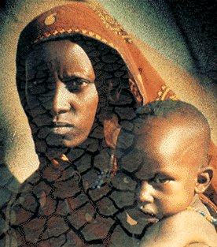
Dr. Pietro Ceccato
Research Scientist,
Lead Environmental Monitoring Program
The International Research Institute for Climate and Society
pceccato@iri.columbia.edu
http://iri.columbia.edu
Notes:
15

